Slide 1
CUSTOMER
AND
ORDER MANAGEMENT
ANALYSIS
BY
INDIRA PRIYA DHARSHINI JYOTHI

Slide 2

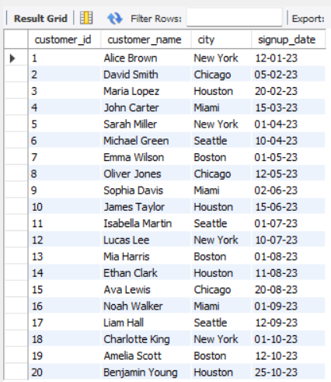
1. List all customers.
Result Table

Slide 3
The customer table shows a well-distributed signup pattern across months.
Multiple customers joined within short intervals, showing steady onboarding.
Customer diversity supports balanced analytics across the dataset.

Slide 4

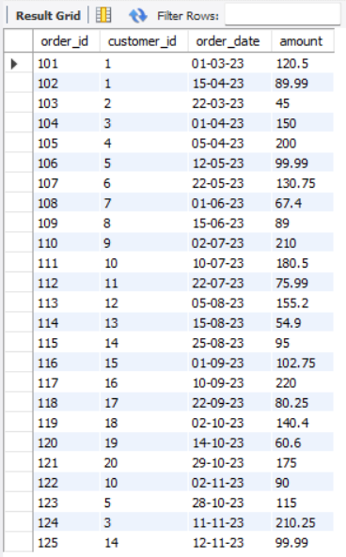
2. List all orders.
Result Table

Slide 5
Orders vary significantly in amount, indicating mixed spending behaviors.
Order dates span across different months, showing repeated business activity.
Some customers contribute multiple orders, while others contribute only one.

Slide 6
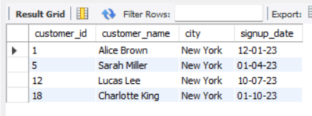
3. Find customers from New York.
It shows whether those customers actively made purchases or not.
Comparing with the orders table reveals their spending contribution.
Result Table

Slide 7
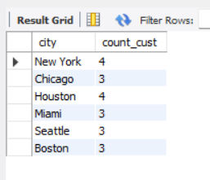
4. Count customers per city.
Higher customer count often correlates with higher total orders.
This distribution helps understand how customer base affects revenue patterns.
Result Table

Slide 8

5. Total revenue generated.
High-value orders significantly boost overall revenue.
The mix of small and large orders creates a balanced revenue curve.
Result Table

Slide 9

6. Average order value.
Average order value reflects both frequent small purchases and occasional large ones.
Helps compare customer behavior between light spenders and premium spenders.
Result Table

Slide 10
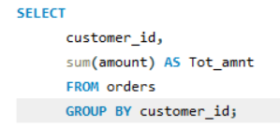
7. Total spending per customer.
This comparison clearly separates high-value and low-value customer groups with repeated orders and high contribution ,less order and least contribution to the revenue.

Slide 11
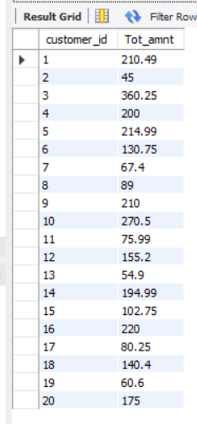
Result Table

Slide 12
Graphical Representation

Slide 13
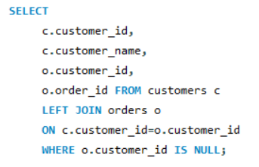
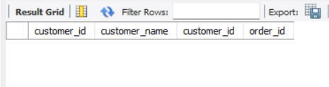
8. Customers with no orders.
These customers signed up but never made a purchase.
Their inactivity highlights missed revenue opportunities.
Result Table

Slide 14

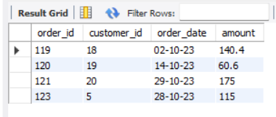
9. Orders made in October.
Monthly filtering highlights customer activity during that period.
It shows whether the month had high or low business.
Result Table

Slide 15
Graphical Representation

Slide 16


.
10. Highest order amount.
The largest order stands out clearly compared to the rest.
It significantly influences total revenue and average order value
Result Table

Slide 17
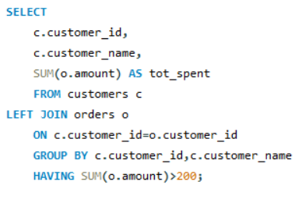
.
11. Customers who spent more than 200 total.
These customers form the premium spending group.
Their contributions make up a major percentage of total revenue

Slide 18
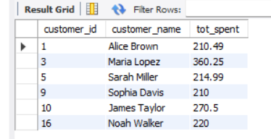
Result Table

Slide 19
Graphical Representation

Slide 20
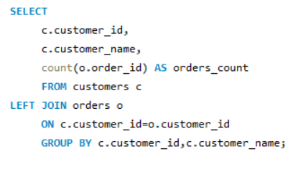
12. Number of orders per customer.
This analysis helps categorize customers into frequent and infrequent buyers.
Some customers place multiple orders, Others place only one order.

Slide 21
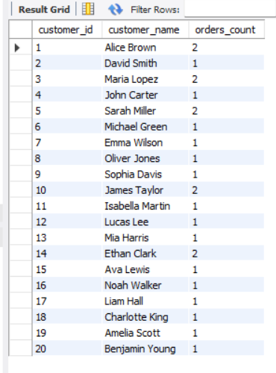
Result Table

Slide 22
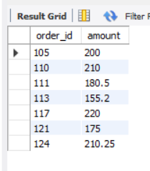
13. Orders over $150.
High-value orders contribute disproportionately to total revenue.
Comparing both tables shows which customers are high-value buyers.
Result Table

Slide 23
Graphical Representation

Slide 24
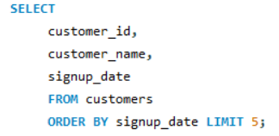
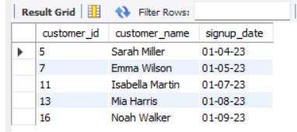
.
14. First 5 customers by signup date.
Early customers often have stronger long-term engagement.
Their purchasing pattern reveals how early adoption affects spending
Result Table

Slide 25
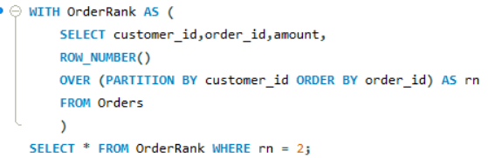
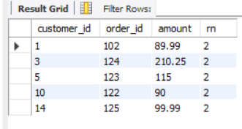
.
15. Last order of each customer.
Recent orders indicate currently active customers.
Older last-order dates suggest declining engagement
Result Table

Slide 26
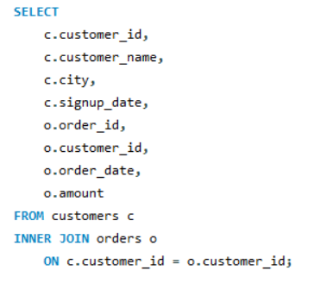
16. Join customer + order details.
Joining both tables shows complete customer activity in one view.
It reveals which customers are contributing the most to revenue.

Slide 27
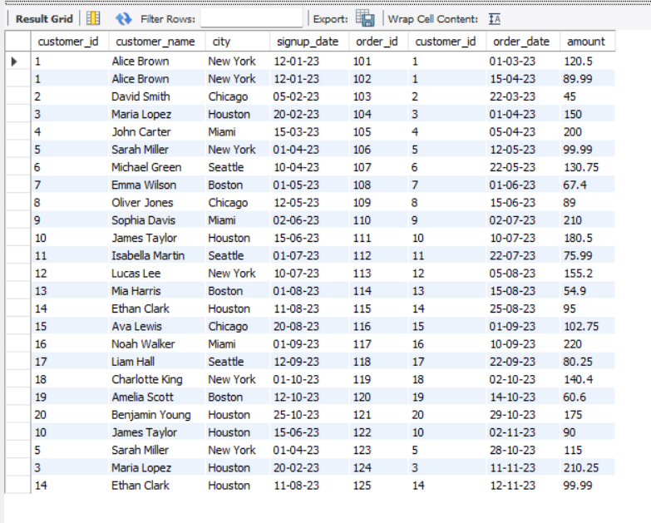
Result Table

Slide 28
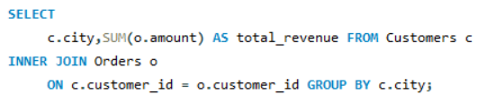
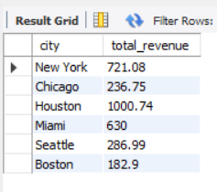
17. Total revenue per city.
Revenue differs based on where more active customers are.
Some locations have fewer customers but higher spending.
Result Table

Slide 29
Graphical Representation

Slide 30
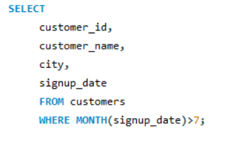
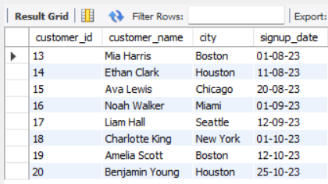
18. Customers who joined after July.
These newer customers show how quickly new users convert into buyers.
Comparing their orders reveals early engagement levels.
Result Table

Slide 31
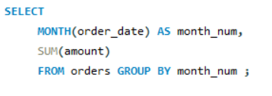
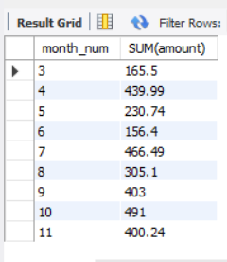
19. Monthly order revenue.
Revenue varies month to month based on customer activity.
Some months show clear spikes, driven by multiple high-value orders.
Other months show fewer orders.
Result Table

Slide 32
Graphical Representation

Slide 33
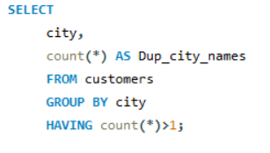
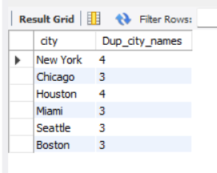
20. Find duplicate city names.
The duplication highlights key areas of customer presence.
This cluster often results in higher total order volume.
Result Table

Slide 34
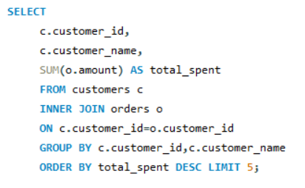
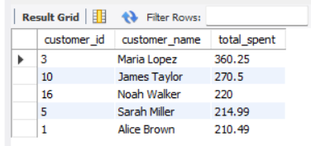
.
21. Top 5 highest spending customers.
These customers contribute the majority of the total revenue.
The ranking highlights clear differences in spending behavior.
Result Table

Slide 35
Graphical Representation

Slide 36
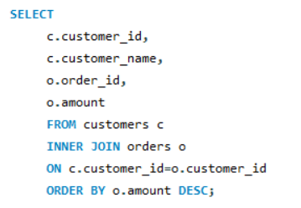
22. Orders sorted by amount (descending).
Sorting highlights the gap between low and high-value orders.
Largest orders appear at the top, showing premium transactions.

Slide 37
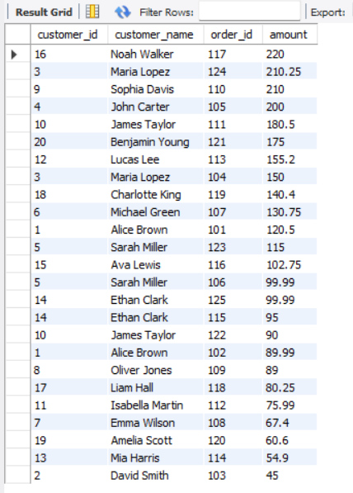
Result Table

Slide 38
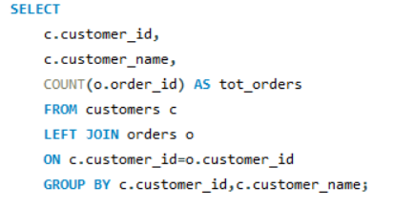
23. Customers and their total number of orders (0 included).
Combines data to show both active and inactive customers.
Highlights customers who signed up but never purchased.

Slide 39
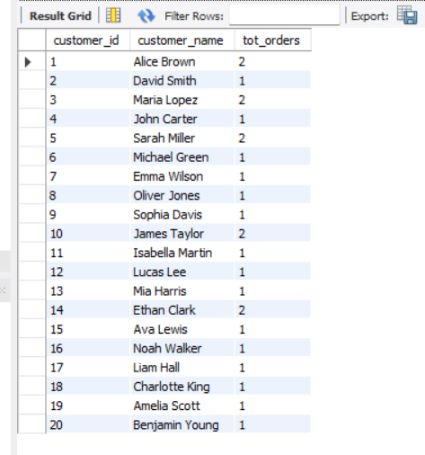
Result Table

Slide 40
Graphical Representation

Slide 41
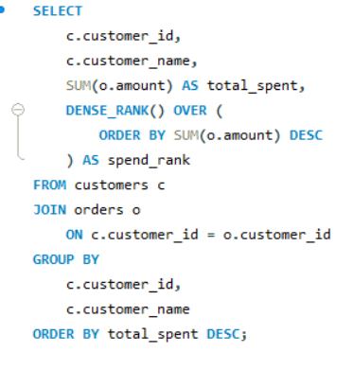
24. Rank customers by spending (window function).
Ranking showcases which customers contribute most to revenue.
It highlights spending differences not visible in raw data.

Slide 42
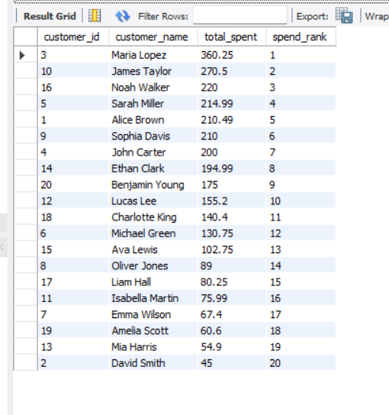
Result Table

Slide 43
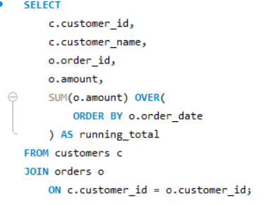
25. Running total of order amounts (window function).
Cumulative revenue shows how earnings build over time.
This trend helps identify the most impactful transactions.

Slide 44
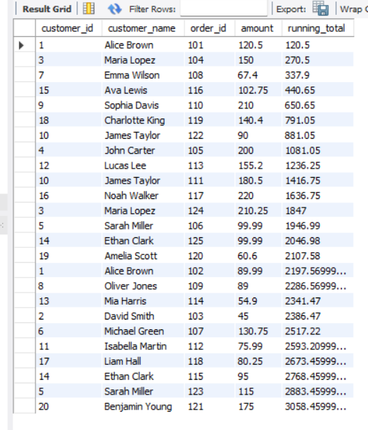
Result Table

Slide 45


